Slide 1

moose for dcs world cargo handling
Release 2.4

Slide 2
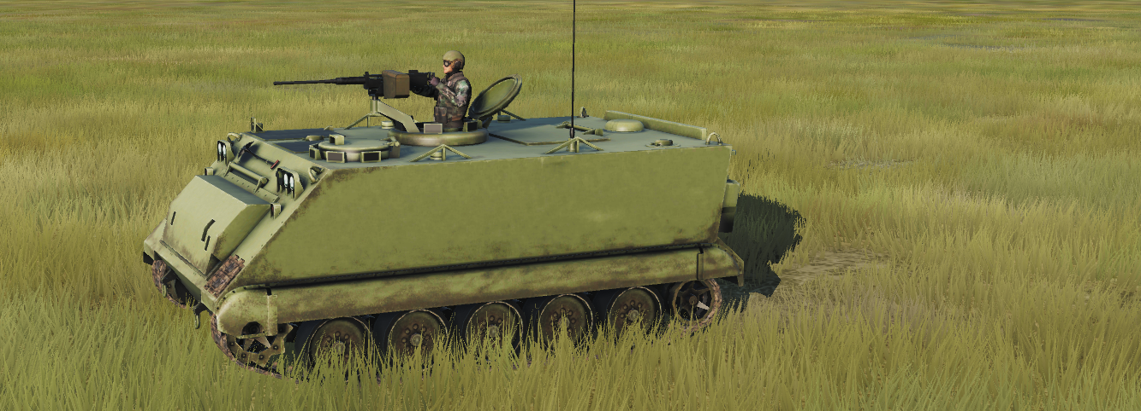
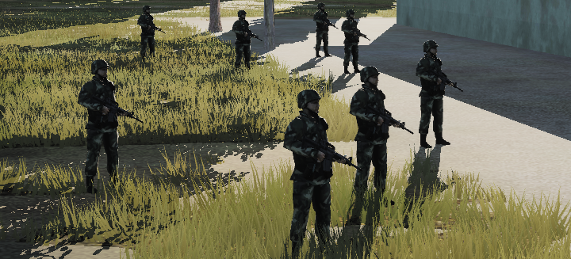
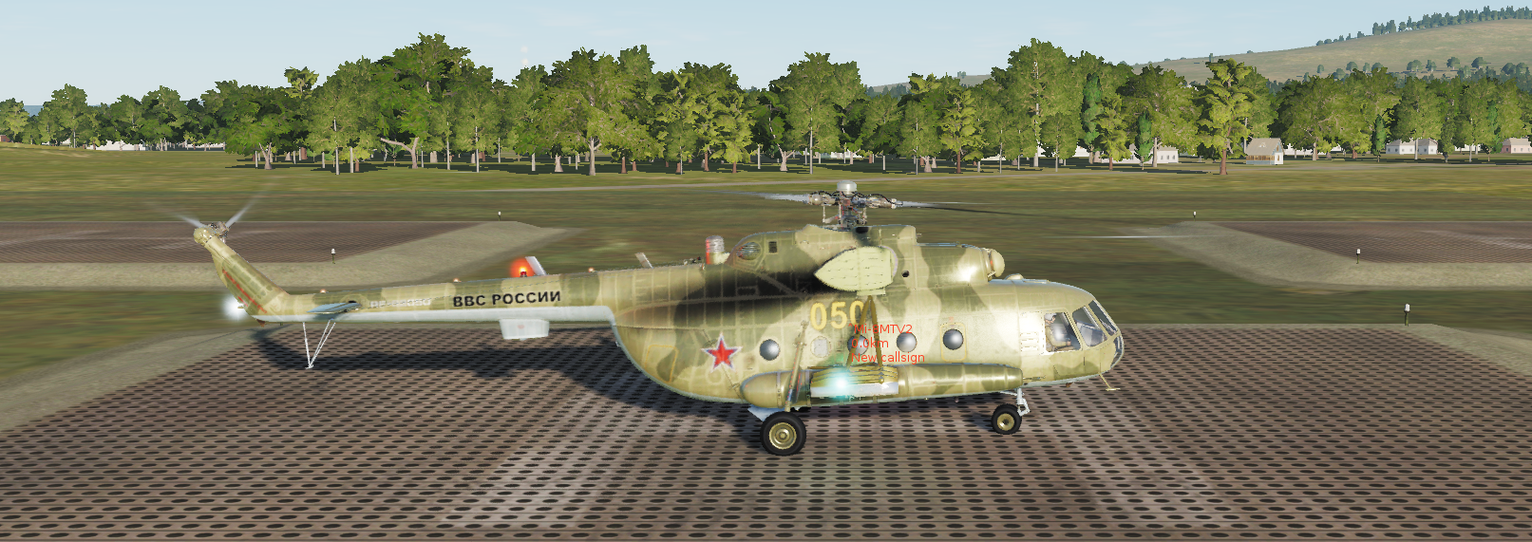
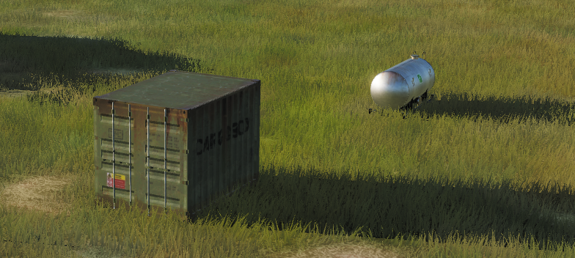
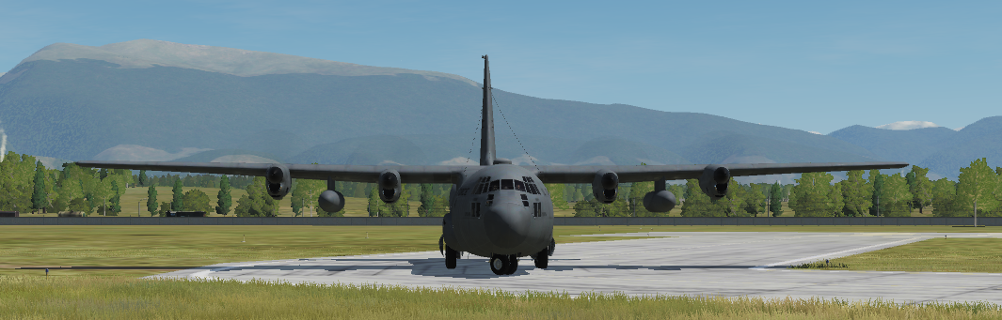
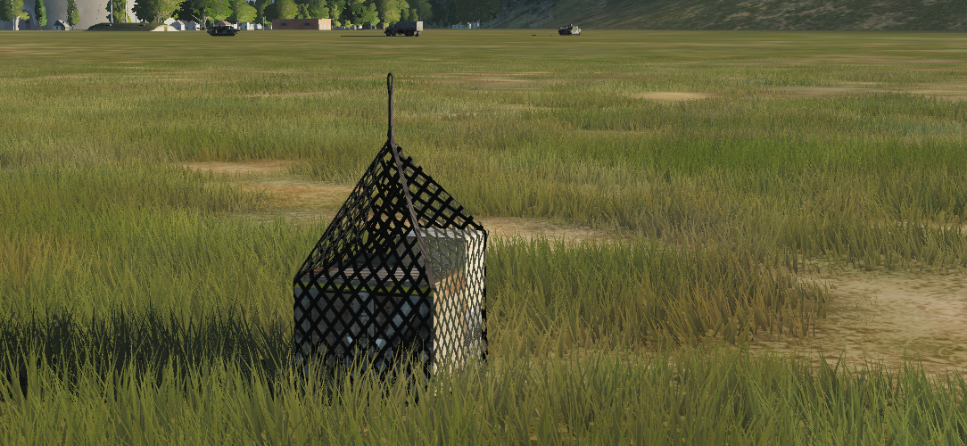
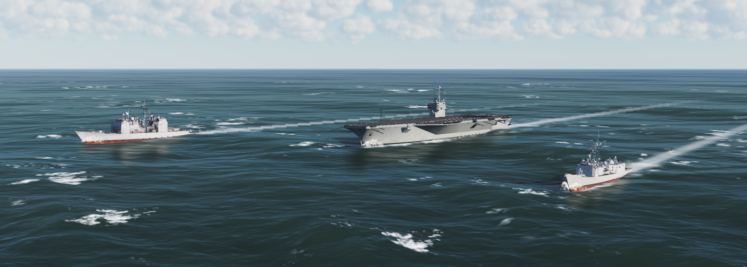
m.o.o.s.e. Cargo system
For different Carrier types
for Different CARGO objects
Armed personnel
Carriers, trucks
Moveable cargo
infantry, small arms
Transport
helicopters
stationary cargo
Crates, small vehicles
Transport
airplanes
Sling loadable cargo
crates
Transport
ships and vessels

Slide 3
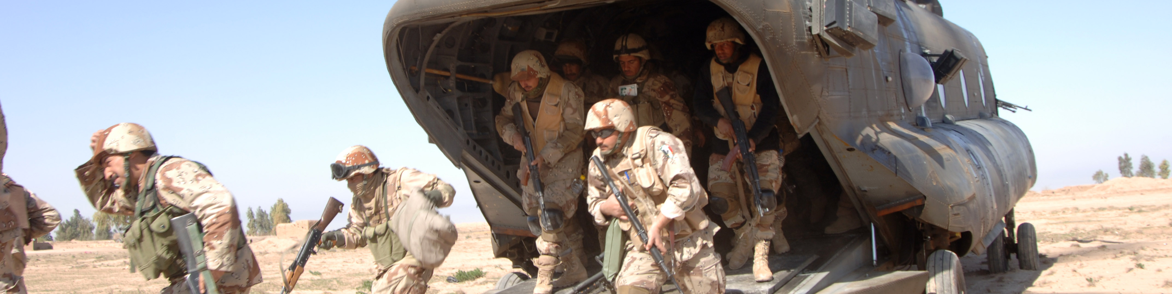
Moveable cargo
Reporting range
Boarding range
Carriers need to move within reporting range and cargo will report.
1
2
Moveable cargo will board when the carrier is within reporting range.

Slide 4
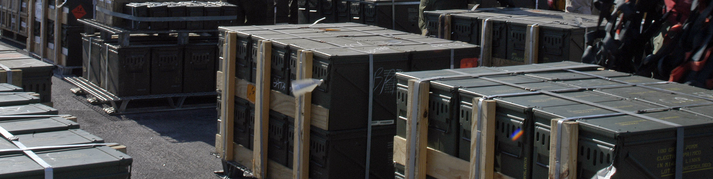
stationary cargo
Reporting range
Carriers need to move within reporting range and cargo will report.
1
The near range is the minimum range to load fixed cargo.
Near
range
2
3
Carriers need to move within near range to load fixed cargo.

Slide 5
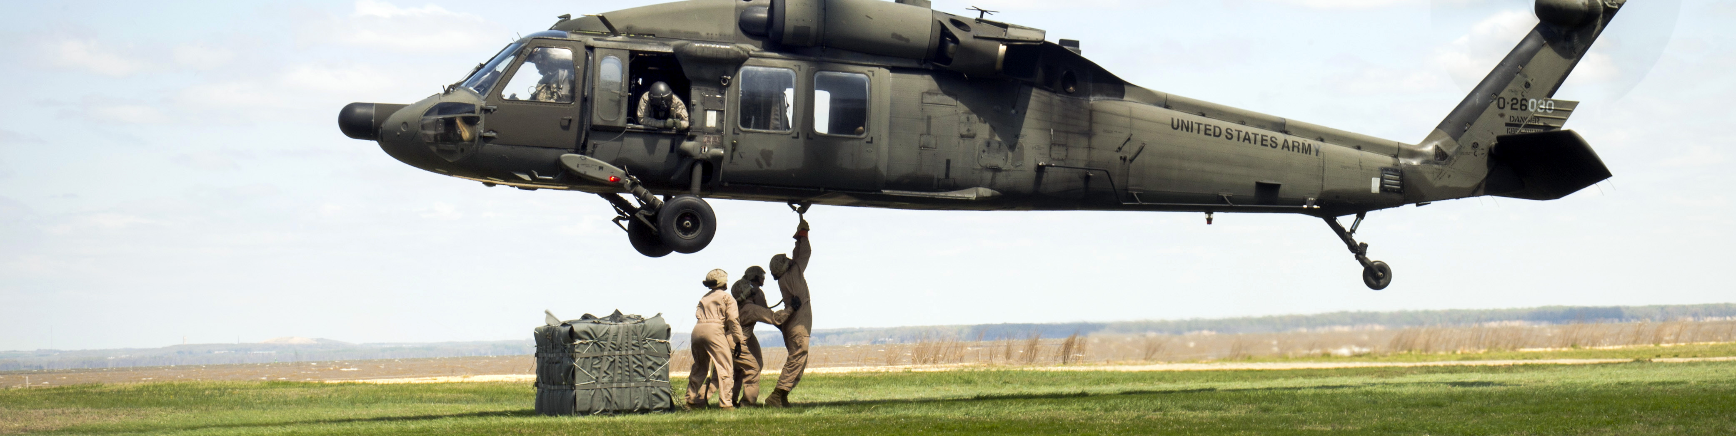
Sling loadable cargo
Cargo
Reporting range
Carriers need to move within reporting range and cargo will report.
1
2
Follow the normal dcs procedure to sling load cargo.
3
Sling loading is only possible with helicopter carriers.

Slide 6
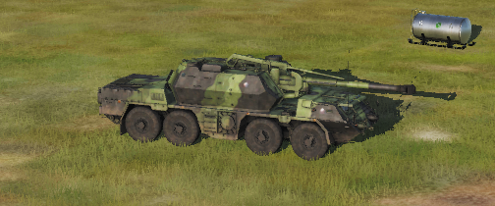
stationary cargo communication
Reporting range
A communication truck needs to be nearby to be able to have stationary cargo location being reported.
1

Slide 7
Declaration of cargo

Slide 8
a small demonstration

Slide 9
PROCESS WORKFLOW EXAMPLE
Idle
Start
Monitoring
Monitor
Stop
Pickup
Monitoring
Load
Monitoring
Loaded
Deploy
Monitoring
Unload
Monitoring
Unloaded
STATE
EVENT

